Slide 1

Secretariat Compliance Review of ExCBs Management of CoC and QARs
2021 Remote Assessor Training August 30th

Slide 2
Management of IECEx QARs and CoCs
Why is the management of IECEx QARs and CoCs so important and how can we ensure the integrity and confidence of the IECEx Schemes are maintained?
The IECEx Certified Equipment Scheme is a Type 5 Product Certification Scheme modelled on (ISO/IEC 17067) that involves Surveillance including management system audits
The requirements of ExCBs operating in the IECEx Certified Equipment Scheme are based on ISO/IEC 17065 that includes requirements for Surveillance
  If the QAR summary has expired (validity date) then the manufacturer cannot claim that the product listed holds a valid IECEx CoC
  The manufacturer MUST remain under surveillance to maintain the IECEx Certificate of Conformity for the product/s being produced at the manufacturing facility
IECEx Certificates linked to ‘out of date’ QARs need to be dealt with and may include
    Organize manufacturer surveillance audit
    Up-issue to valid QAR
    Suspension until manufacturer is back under surveillance
    Cancellation of the CoC
The IECEx OCS back office reports highlight that many ExCBs (est. 20%) do a poor job in managing their CoCs and QARs

Slide 3
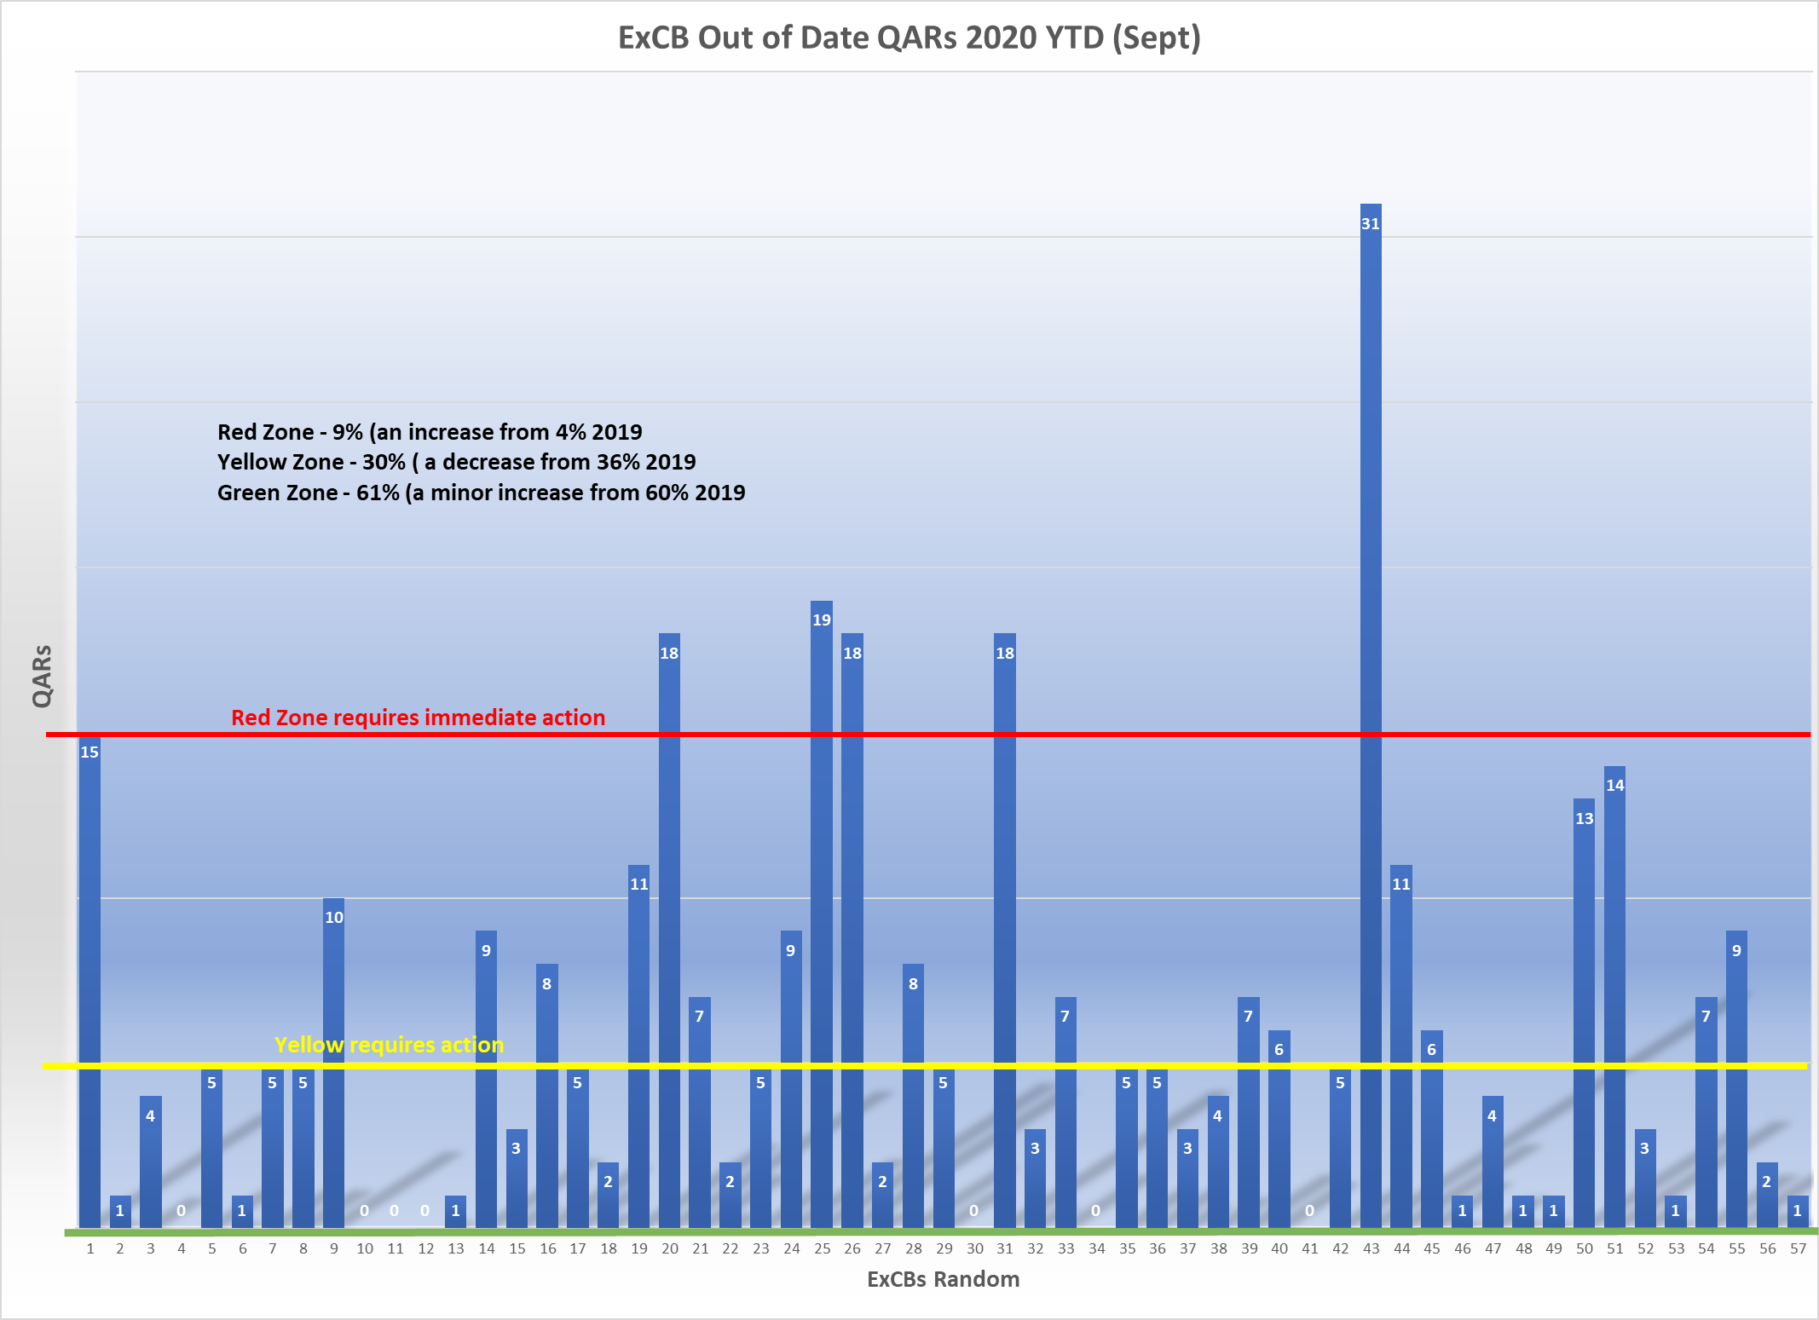

Slide 7
Why do QARs go out of date and what happens to the CoCs?
  Surveillance or re-assessment no longer conducted or delayed by ExCB (internal process poorly managed)
  Manufacturer may discontinue products (refer to OD 209 about Cancellation)
  Manufacturer does not respond to ExCB to schedule surveillance or re-assessment (refer to OD 209 and OD 250 about Suspension/Cancellation)
  Manufacturer selects a different ExCB to conduct its IECEx assessment audits, and a new QAR is then generated and not all CoCs are up-issued to new QAR (refer to OD 250 about ExCB actions required)
    May result in numerous CoCs no longer showing the reference to the correct QAR which is valid

Slide 8
IECEx OCS Back Office - Reports
ExCBs can access reports in the IECEx OCS back office that:
  Provide a list of their QARs ‘out of date’
  Provide a list of CoCs issued by the ExCB that are linked to their QARs and other ExCBs QARs that are ‘out of date’
  These are useful tools for the CB, but in reality as per ISO/IEC 17065 their management system should demonstrate internal tools to manage CoCs issued
  The Secretariat also provides this information to the Assessor as part of the Desktop Review (DTR) prior to a mid-term or re-assessment

Slide 9
Key challenges
When a CB issues a CoC linked to their QAR, the management of CoCs are straight forward (less of an issue)
When a CB issues a CoC and they link it to another CBs QAR, then the management of CoCs may be poorly maintained
  The interdependence of CBs on each other becomes evident
  The management of the CoCs becomes challenging for CBs
  The management of the CoCs may be challenging for the manufacturer
Manufacturers may be unaware of the consequences when they change CB for QAR audits
  May result in CoCs not being up-issued to the new QAR, or taking months and sometime years to achieve this
  Should there be a clause in all CBs T&C that if a manufacturer changes CB to continue QAR surveillance, then they must instruct the other CBs to ensure the CoCs previously linked to the old QAR are up-issued to the new QAR (IECEx technical change of CoC) and are aware of the cost implications?
Assessors ask CBs during the mid-term assessment if they have any CoCs linked to out of date QARs, then have them log into the IECEx back office - Reports and show the assessor if and how many CoCs they have and how many are linked to other CB QARs ‘out of date’. If the number is excessive then this is recorded as an action.

Slide 10
Conclusion
Assessors requested to put more emphasis during the mid-term surveillance or re-assessment to ensure ExCBs are managing their CoCs and QARs
Secretariat to review IT processes to continue to evolve the IECEx OCS system so the management of CoCs and QARs are more easily managed
Secretariat compliance role continues to monitor and assist ExCBs ensuring good house keeping of the IECEx OCS
Hold ExCBs accountable for not meeting a high standard of maintaining the IECEx OCS (CoCs and QARs)

