Slide 1
IECEx Assessor Training –
30 August 2021 Remote
Chris AGIUS + Christine KANE+ Mike ROY
IECEx Secretariat

Slide 2
Role of IECEx Assessors ???
Carry out the Formal Assessment of ExTLs and ExCBs under the IECEx Peer Assessment Process, in line with ISO/IEC 17040 + IECEx Rules and Operational Documents, ODs
IECEx Assessors are the “Eyes” and “Ears” of the IECEx Membership and Stakeholders that rely on IECEx Certifications, to ensure ExTLs + ExCBs meet IECEx requirements
National accreditation held by ExTL and ExCBs a good start BUT NOT the complete story – does not take into account the IECEx Rules and Standard Operating procedures (ODs) nor the type or format of reporting (ExTRs + QARs) nor the issuing of IECEx CoCs
IECEx Assessors carry IECEx on their shoulders!
Notes:
The IEC was founded in 1906 as a direct consequence to the World’s Fair in St. Louis in 1904 where electric energy was the central focus.
The exhibits that occupied the Palace of Electricity not only used electricity of numerous different voltages, but also either direct current or 1-, 2-, or 3-phase alternating current, with many different frequencies and variations of connectors and plugs.
It became clear to scientists that in order to build on each other’s research and stimulate further development of this new technology as well as commercialization and the creation of markets, standards where needed.

Slide 3
Role of the IECEx Secretariat
Day to Day running of the System
Financial Management, with Treasurer and Executive
Oversee Development of new services
Support IECEx Committees+WGs Maintenance of existing services and supporting elements, eg Documentation, website etc
Assist with Promotion and Marketing and growth.
Compliance, eg:
  Industry complying with IECEx Rules and General Business practise, eg any misuse of the IECEx
  Membership Compliance, eg ExCBs+ExTLs
  Secretariat Compliance with roles and responsibilities

Slide 4


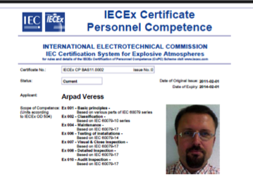
IECEx Certification Schemes
Choice between:
IECEx System
IECEx “Certificate of Conformity”
IECEx Equipment Scheme
Certification of Ex Equipment
IECEx Equipment Scheme
Certification of Ex Equipment
IECEx “Component Certificate”
IECEx “Unit Verification” Cert.
IECEx Conformity Mark License
IECEx Services Scheme
Certification of Ex Service Providers
IECEx Certificate of Personal Competence Scheme (CoPC)
IECEx Recognised Training Provider Program (RTP)
Recognition of Training Bodies supporting CoPC

Slide 5
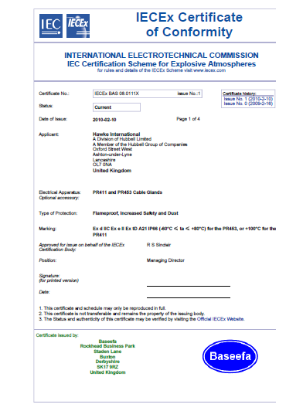
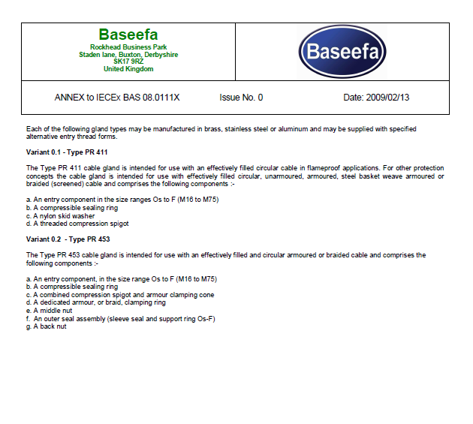
IECEx On-Line Certificate System
An IECEx Certificate is more than just a piece of paper or electronic file!!!
It is a Compliance Instrument used by different stakeholders, including Inspectorates + Regulators.
Key Message:
<Certificates need to be clear + Credible>

Slide 6

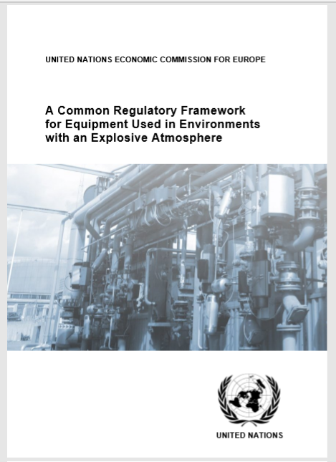
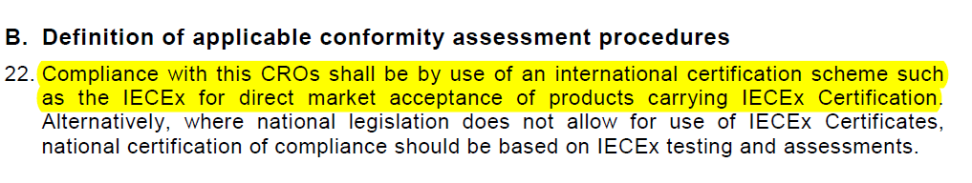
How is IECEx used within Countries?
Regulatory: Government Regulations may require compliance with IEC TC 31 Standards AND accept Ex Products, Services (e.g. Repair Workshop), or Competent Persons covered by IECEx certification satisfy safety requirements of the country.
  IECEx - Recommended by the United Nations, UNECE publication for adoption with Regulating Ex areas.
Contractual: Companies purchasing Ex Equipment and Services may require IECEx Certification as part of their Procurement process and Risk Mitigation for Compliance with Safety Standards.
Voluntary: Companies offering Ex Equipment and Services may use IECEx to promote their goods and services, e.g. market differentiation
Mutual Recognition: Testing and Auditing Reports (ExTRs / QARs) used by Certification and Approval bodies to grant their local Approvals and certifications

Slide 7
Fundamentals for Credibility
ExCBs and ExTLs must:
  Have facilities + Personnel with necessary Expertise
  Comply with ISO/IEC 17065 / 17025 / 17024 as appropriate
  Implement the IECEx Rules + ODs + Forms
  Follow IECEx Rules of Procedures, IECEx 02, 03, 04, 05 etc and Operational Documents ODs
IECEx ExCB/ExTL Assessments must:
  Confirm the above for ExCBs and ExTLs in the respective IECEx Schemes
  Be conducted according to the IECEx Rules and ODs governing peer assessments
  Have the confidence from IECEx Members, Industry, Regulators and all stakeholders

Slide 8
IECEx Expectation of IECEx Assessors
  At all times Act Professional and in the interests of the IECEx
  Have full working knowledge of the IECEx Rules and ODs
  Have sufficient technical knowledge and expertise
  That a thorough and complete assessment is conducted
  When raising a Non Compliance or potential issue, be sure to link it with a requirements of the Scheme, i.e. reference the Standards (eg ISO/IEC 17065) / IECEx Rules / OD and Clause reference
  You are the Eyes and Ears of the IECEx community
  Ensure all reporting and forms are complete
  Be mindful of the ExCBs and ExTLs investment in IECEx by providing timely responses and maintain communication prior, during and after assessment

Slide 9
Secretariat Feedback + Reminders !!
  Appreciates the concerted efforts by all Assessors+ ExCBs/ExTLs that have ensured that the IECEx ExCB/ExTL assessment program maintains credibility Thank You
  Timely response to issues and communication – especially when resolving Nonconformances
  Assessor Travel Documentation e.g. notification for visa and allow sufficient time
  Use of Updated IECEx Forms https://www.iecex.com/members-area/new-document-library-page/assessors-package/
  Ensure reports are complete and assume the reader needs full information – do not assume the reader knows!!! Show closure of any items raised
  Listing of Tests witnessed in the final report to ExMC
  F004 Site Assessment report – all items to be shown as closed before sending to Secretariat
  Secretariat Reviews Reports from Lead Assessors – effective communication required

Slide 10
Secretariat Feedback + Reminders !!
  Use of Desk Top Review Report (DTR) as provided by the Secretariat where applicable
  Use current Forms – refer Assessor Package https://www.iecex.com/members-area/new-document-library-page/assessors-package/
  TCD – be careful to ensure that requirements marked with an * have been completed to show where/how the testing capability is achieved. ALL sections of TCD to be completed relevant to the ExTL’s scope
  TCD Example
  Subcontracting / Contracting (New ExTAG/662/Inf) for backgroud
  Finances + Invoices (to be clear what it is for and payment currency) – Await costs confirmation acceptance from Body prior to starting. Noting some costs estimates seem to vary and will be reviewed to provide further guidance to that provided in OD 032 for post COVID
  Be knowledgeable about the IECEx On-Line Certificate System https://www.iecex-certs.com/home Secretary happy to provide a tutorial
    Remember OD 011 series Guides for use of the IECEx On-Line Certificate System

Slide 11
Response to COVID-19
  New OD 060 – Edition 2.1 ready
  Provisions for use of Remote assessment, including for applicants
  Covers handling of Audits of manufacturers and Facilities by ExCBs
  Dr Munro as ExAG Convener will cover remote assessments in more detail
  Appreciate how Assessors and ExCBs/ExTLs are adapting to the new OD 060
  Looking ahead
  A survey of Assessors was conducted as part of Lessons Learned and report issued as ExMC/1753/Inf thanks to all Assessors for participating – Valuable information to be used for reviews within ExAG for going forward Post COVID
  Travel bans likely to continue for some countries for some time
  Secretariat and Officers of the IECEx Assessment Group, ExAG (Dr Munro Ms Holdredge) are available to support.

Slide 12
Response to COVID-19
Reporting on use of Remote provisions
  Extract from an issued Report where Remote provisions were part of Overall Assessment, prior to COVID using OD 032 provisions:
  DATES OF ASSESSMENT:
The assessment program involved a combination of off-site reviews and assessment of documentation and records along with video conferencing for interviews and clarification of documentation and procedures plus a site visit to assess facilities on-site at Perth AU, plus further off site assessments both prior and following the conference & on-site visit. The following are a record of key events during the assessment process:
12-14 May 2018 – Assessment Team Leader review of initial documentation for assessing compliance with ISO/IEC 17024
16 May 2018 – Initial face to face assessment via video conference to continue with ISO/IEC 17024 assessment and compilation of checklist
23 May 2018 – New + Revised set of documentation submitted to address issues raised by Assessment team leader on 16 May 2018 assessment. Revised documents reviewed by Assessment team 24+25 May 2018
28 May 2018 – site visit assessment by Assessment team leader with Peer assessor participation vis video conference to assess facilities, management, staff and competence of examiners
31 May 2018 – submission of matters to address corrective actions, including the registration of a new Company to address issues raised during assessment.
4 June 2018 – review of corrective actions and preparation of final ExMC voting report

Slide 13
Response to COVID-19
Reporting on use of Remote provisions
A briefer version to previous
12 May 2018 to 23 May 2018 – Assessment of Applicant ExCB documentation for compliance with ISO/IEC 17024 and IECEx Scheme Documents including reviews of corrected versions from issues raised
28 May 2018 – Site visit conducted
31 May to 4 June 2018 – Review ad closure of Corrective actions and issue of final ExMC report
The important point is to briefly record when things were done to provide the IECEx Community with confidence that adequate time was allocated to conduct a thorough assessment

Slide 14
ExCB Management of CoC and QARs
To be covered by Mike Roy – IECEx Compliance Manager

