Slide 1

IECEx On-line Bulletin
Geoff Slater
IECEx Secretariat
Edinburgh
September 2023

Slide 2
IECEx Bulletin Background
The IECEx Bulletin is a publication of the IECEx that provides a global, up-to-date list of standards operated by the IECEx and the status of acceptance or national differences of each member country. The publication is accessible to IECEx members, ExCBs and ExTLs as required by the rules stated in IECEx 02.
The Bulletin promotes consistency and harmonization in the implementation of Standards operated by the IECEx.
Current edition of the Bulletin is Edition 5 published in 2016.

Slide 3
Issues with current bulletin
Static document
36 members have to contribute, and there are over 38 standards with multiple editions of each standard
Takes ~12 months to compile and publish as each National Member Body has to be contacted and they have to respond. This is a time consuming, inefficient and slow process
Can be out of date by the time it is published.
Solution The On-Line Bulletin
Members will be able to update the On-Line Bulletin and immediately publish – it becomes a live document.

Slide 4
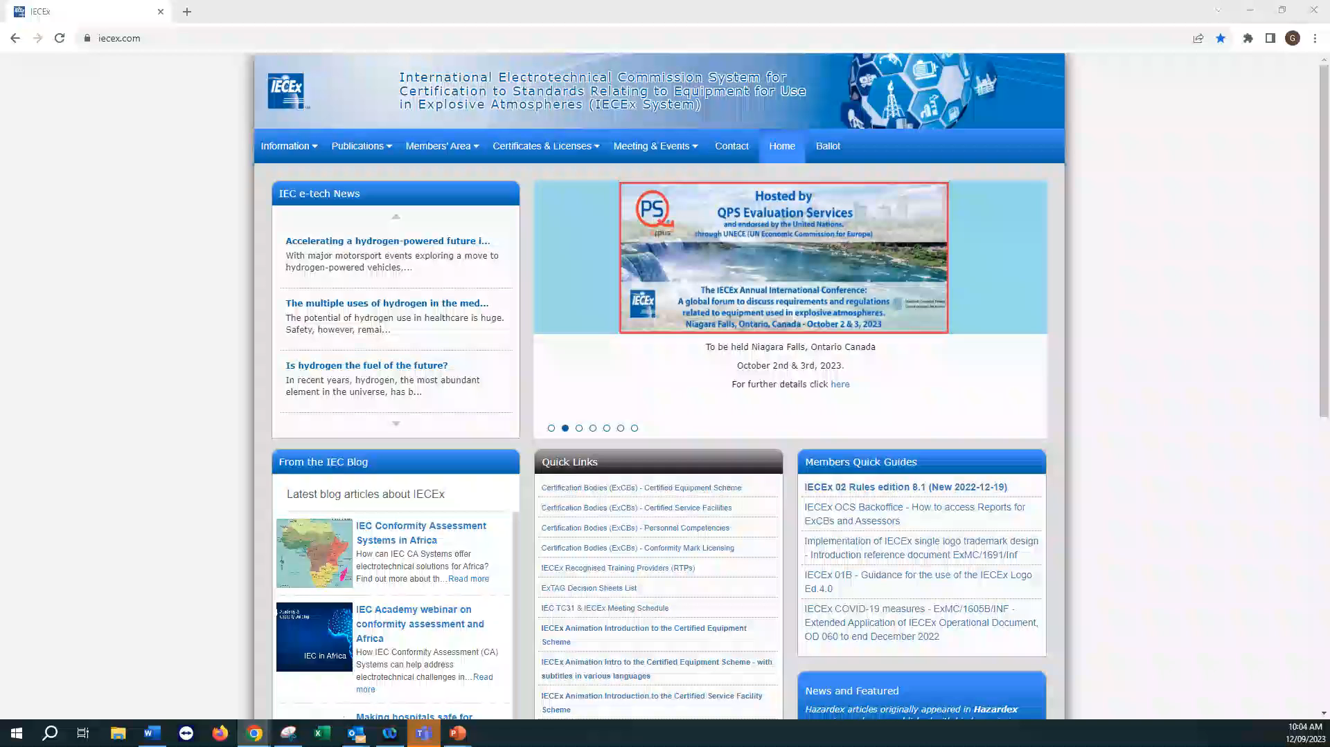

Slide 5
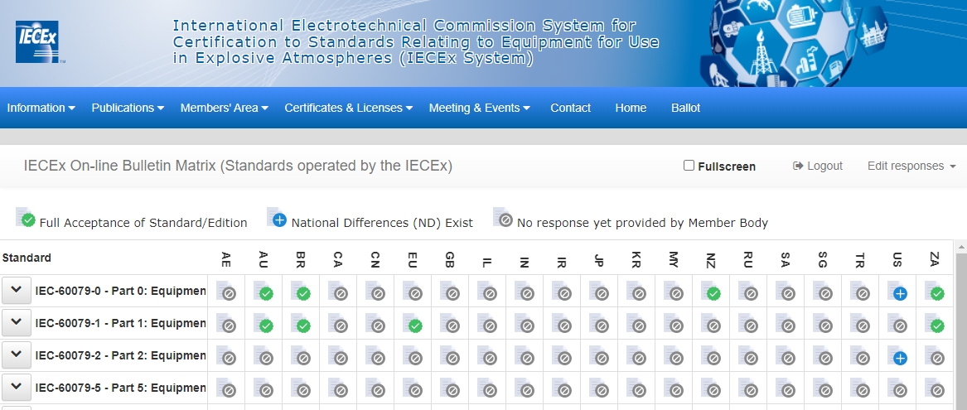
On-line Bulletin
Notes:
Show the matrix
Demonstrate content
The legend
Country abbreviations
X Y highlighting – cross hairs
Standards and versions

Slide 6
Access Rights
Types of Access
  Public viewing
  ExCB/ExTL full content access rights (view only)
  Member body or delegate admin rights (edit/populating member body/country data only)
  Secretariat admin rights
  Circular to be sent for secure access password

Slide 7
Implementation Plan
October
Send requests to member bodies to nominate their representatives
Send requests to ExCBs and ExTLs to nominate staff requiring access
Complete programming
November
Testing by Secretariat
Issue passwords.
Publish OD 211 which will be the user manual for the system.
Complete upload of Bulletin Edition 5 data by IECEx Secretariat.
December
Go live.

Slide 8
Thank you

